Slide 1
Olympic Connect
A unified network of partners that seamlessly connects people to the support they need to thrive.
PRESENTATION TITLE, DATE
Notes:
Hello, I’m [YOUR NAME & ROLE].​
Thanks for inviting me to share a little about an exciting new service of Olympic Community of Health we are getting ready to launch by early 2025, which we hope will dramatically improve the lives of community members throughout Clallam, Jefferson, and Kitsap counties through how we address social needs. ​
It’s such an honor to be here with you today…
[YOUR PERSONALIZED INTRODUCTION]..
I invite you to take a moment to think of someone in your life, maybe personally or professionally, who could benefit from more support around social needs – things like housing, healthy, affordable food, social connections, transportation, etc. Keeping this example in mind I hope you'll get excited about the path forward.

Slide 2
Who we are
Tackle health issues no single sector or tribe can tackle alone.
Notes:
Olympic Community of Health, or OCH, was formed in 2017 to bring partners together from a variety of backgrounds, disciplines, perspectives, and experiences with a purpose of solving health issues through collaborative action.

Slide 3
Who we are
A non-profit organization that serves Clallam, Jefferson, and Kitsap counties.
Partner with 7 Sovereign Nations: Hoh, Jamestown S’Klallam, Lower Elwha Klallam, Makah, Port Gamble S’Klallam, Quileute, Suquamish.
Overarching goal to “improve individual and population health and advance equity by addressing the determinants of health.”
Notes:
OCH is a non-profit organization that serves the Olympic region – Clallam, Jefferson, and Kitsap counties and seven sovereign tribal nations​.
In 2021, the OCH Board of Directors adopted a new strategic plan. Through this collaborative effort, we identified a broad, overarching goal for the organization which is to “improve individual and population health and advance equity by addressing the determinants of health”. ​
​

Slide 4
Who we are
We tackle health issues no single sector or tribe can tackle alone.
We solve health problems through collaborative action.
The community
care hub for the Olympic region.
Networked with 9 Accountable Communities of Health across the state.
A Community Care Hub of Washington.
Notes:
OCH is in process of launching a new initiative, Olympic Connect, and I’d like to share a little about that with you today in hopes that you’ll partner with us on this important work.

Slide 5
Why Address
Social Needs?
Social needs have been shown to impact health and well-being.
Notes:
Before we dive into Olympic Connect, I’d like to first explore why addressing social needs matters.
Over two decades of research demonstrates the negative impacts of adverse social conditions on health and well-being. Poverty, job insecurity, housing instability, food insecurity, lack of educational support, social isolation, and more have been shown to impact health.

Slide 6
Why address social needs?
The Olympic region faces a series of complicated health issues.
Trying to address these health issues on our own often feels like paddling against the current.
We need a unified, collective approach, co-creating a healthier Olympic region for everyone to live and thrive.
Notes:
The Olympic region faces a series of complicated and interconnected health issues. Trying to address these on our own often feels like paddling against the current.
Recently, investments in housing, income support, nutrition, education, and care coordination are proving to be effective strategies to improve health and reduce the cost of care.
We need a unified, collective approach, co-creating a more coordinated and collaborative system, which will help us work towards a healthier Olympic region for everyone to live and thrive. ​

Slide 7
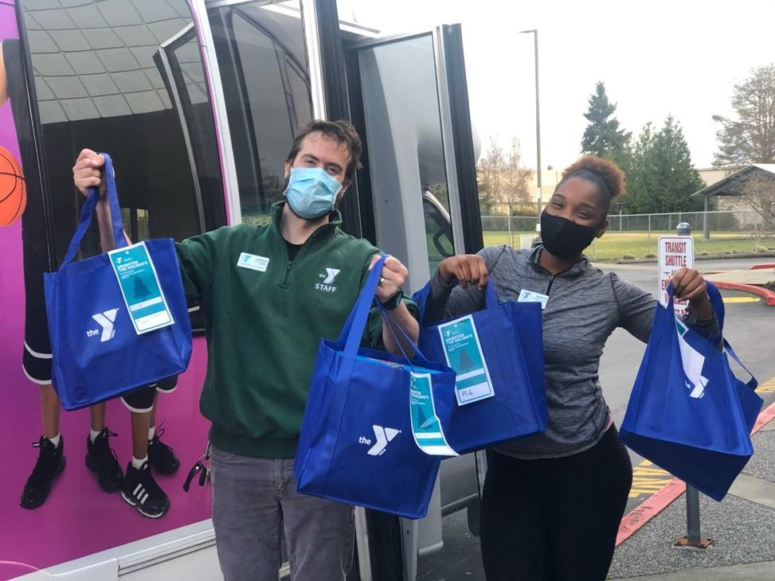
Why Address Social Needs?
Partners have been working tirelessly over the years to support community members in addressing social needs.
Olympic Connect intends to create an aligned regional approach to how we address social needs.
Notes:
Partners across the Olympic region have been working tirelessly over the years to support community members in addressing social needs such as housing, transportation, healthy food, and more. ​
So, I acknowledge that the work you’re doing to address social needs isn’t new.
Olympic Connect intends to create an aligned regional approach to how we address social needs.

Slide 8
What is a
Community Care Hub?
A community-driven network of partners.
Notes:
To this end, OCH and our sister organizations across Washington State are working with key state and federal funders and our local partners to establish a statewide network of Community Care Hubs. ​

Slide 9
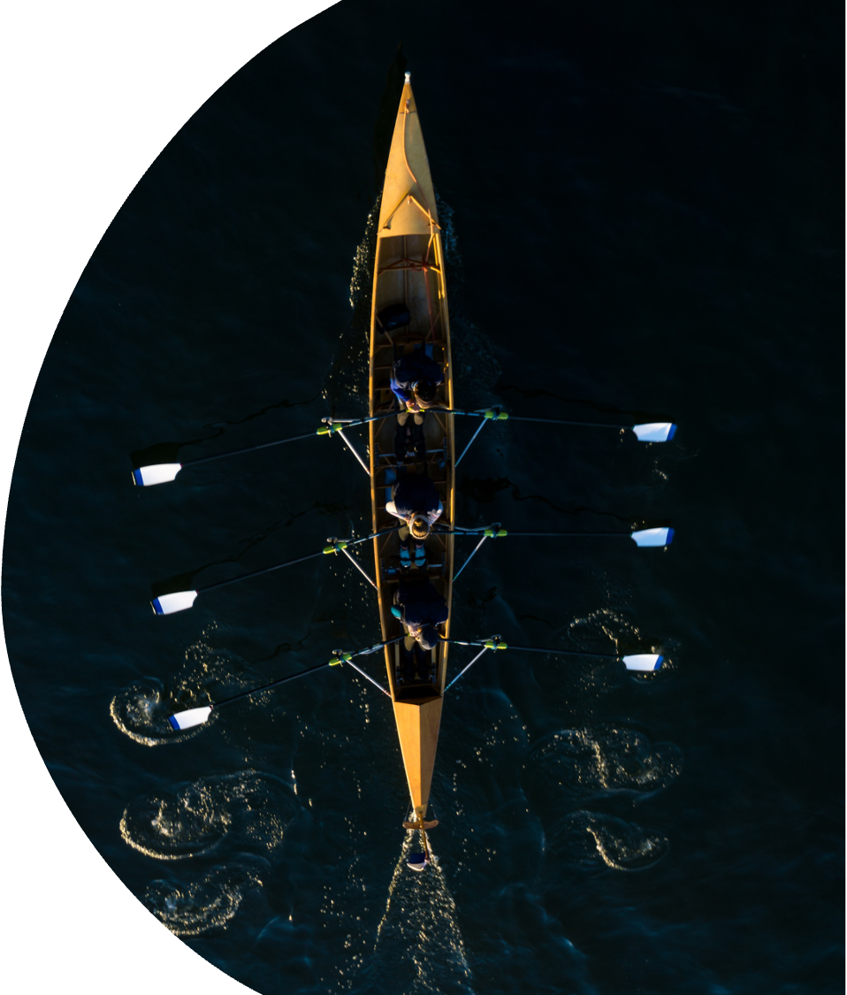
What is a Community Care Hub?
A community-centered entity that …
Supports a network of partners providing services and resources to address social needs
Centralizes administrative functions and infrastructure
Has relationships with and understands the capacities of local organizations and fosters cross-sector collaboration
Notes:
A community care hub is a community-centered entity that: ​
Supports a network of partners providing services and resources to address social needs​
Centralizes administrative functions and infrastructure, and ​
Has relationships with and understands the capacities of local organizations and fosters cross-sector collaboration. ​

Slide 10
What is a Community Care Hub?
We tackle health issues no single sector or tribe can tackle alone.
We solve health problems through collaborative action.
The community
care hub for the Olympic region.
Networked with 9 Accountable Communities of Health across the state.
A Community Care Hub of Washington.
Notes:
OCH will serve as the community care hub for the Olympic region, and we will call our hub Olympic Connect.

Slide 11
What we do
Connect people to care and services through trusted helpers.
Notes:
Olympic Connect connects people on the Olympic and Kitsap Peninsulas to care and services through trusted helpers. These community-based workers connect people to resources like health care, food assistance, childcare, housing, and more. By removing barriers to these services and supports, we can create a region of healthy people and thriving communities.

Slide 12









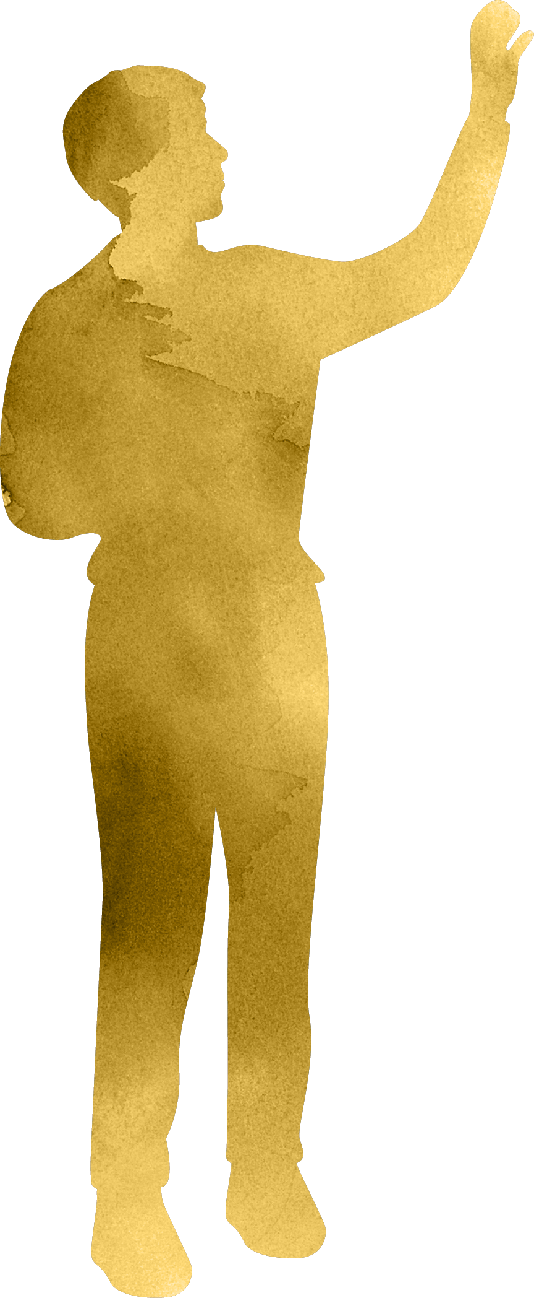

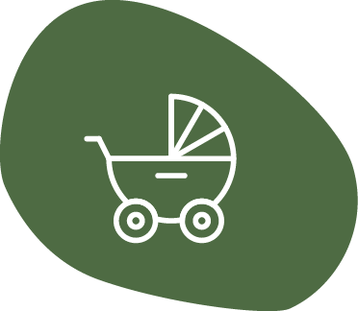



What we do
Our communities can’t thrive if people don’t have what they need for optimal health and well-being.
Siloed efforts. Our efforts to address social needs are largely siloed.
Insecure funding. Organizations may not have sustainable funding to meet the needs.
No systems to track. There isn’t a system to track and address gaps in available resources or to see how our efforts are paying off.
Notes:
Our communities can’t thrive if people don’t have what they need for optimal health and well-being.​
Currently, you might see that our efforts to address social needs are largely siloed.
Organizations providing services often have to chase grants and may not have sustainable funding to meet the need.
There aren’t systems in place to track and address gaps in available resources, or, to broadly track health outcomes to see how our efforts are paying off. ​

Slide 13
What we do
Funding
  Care coordination for social needs
  Expand & enhance social needs resources and services
  Build capacity of and provide training for the community-based workforce
Shared regional technology
Outreach, engagement, and communication
Data, analytics, and evaluation
Alignment, coordination, and convening
Continuous improvement over time
Notes:
Olympic Connect will bring the following to the region:​
Funding to provide care coordination for social needs​
Funding to expand and enhance social needs resources and services ​in our local communities
Funding to build capacity of & provide training to the community-based workforce​
Community-based workforce is a broad term used to identify the on-the-ground workforce that is dedicated to helping connect people to the care and support they need to thrive. This workforce goes by many job titles including Community Health Worker, Case Manager, Care Coordinator, Outreach Coordinator, Peer Navigator, and more.
Shared regional technology including:
a regional resource directory which will catalog up to date information on the available resources and services to support and address social needs​.
And a client management system for a more regional systematic approach to providing care coordination for social needs.
The shared regional technology will also provide regional systems to track and address gaps in services as well as capture health outcomes to see how our efforts are paying off.
Olympic Connect will include robust outreach, engagement, and communication in a variety of languages, formats, and mediums to connect people in various ways and leverage trusted local messengers​
Data, analytics, evaluation, and reporting in order to better capture regional gaps and challenges as well as demonstrate local successes​
Olympic Connect will embody continuous improvement. This work will start small and we'll work to improve over time.​

Slide 14
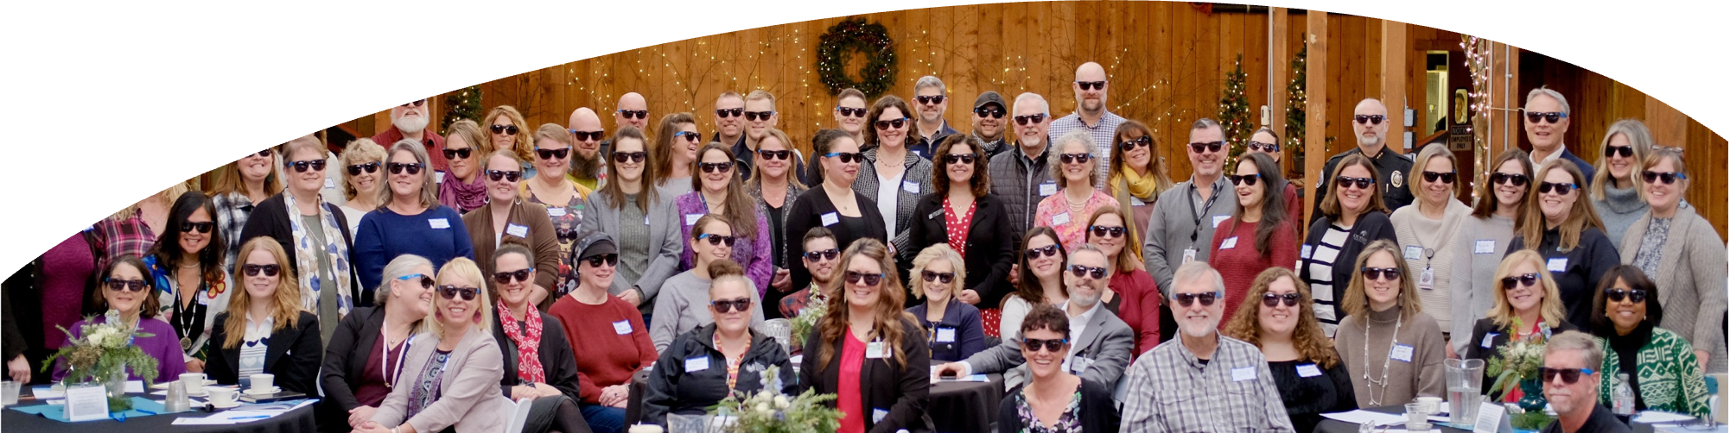
Value we provide to our partners
Strengthened regional social service delivery
Insights from regional data
Promotion of partner expertise
Shared learning
Sustainable financing
Elevation of community voice
Administrative support
Reduced social admissions
Notes:
Olympic Connect aims to add value to our regional partners through…
Strengthened regional social service delivery
Insights from regional data
Promoting partners to focus on the work they do best
Fostering opportunities for shared learning
Providing a pathway towards sustainable financing for social needs
Elevating community voice
Providing administrative support
And the potential to reduce social admissions and social bed days.

Slide 15
What we do
Connect people to care and services through trained and highly skilled trusted helpers
Strengthen our regional network of partners
Coordinate between health care and social service providers
Connect regional resources and track health outcomes for healthier individuals, families and communities
Law enforcement & first responders
Hospitals
Elected officials
Physical health
Behavioral health
Community members
Local government
Schools & colleges
Tribes
Public
health
Health
plans
Community-based & social service organizations
Notes:
In a nutshell…Olympic Connect is a Community Care Hub of Washington
That connects people on the Olympic and Kitsap Peninsulas to care and services through trained and highly skilled trusted helpers. ​
These community-based workers connect people to resources like health care, food assistance, childcare, jobs, and more. ​
Olympic Connect will strengthen our regional network of partners. A robust partner network provides care, services, and resources to address social needs and support community member goals.​
Olympic Connect will connect regional resources and track health outcomes.
By removing barriers to these services and supports, we can create a region of healthy people and thriving communities.

Slide 16
Olympic Connect:
How does it work?
Olympic Connect is there to catch you with care.

Slide 17
Olympic Connect: How does it work?
DISCHARGE
RESOURCES & REFERRALS
Accountability and track outcomes
Connect and
follow up
ENGAGEMENT
Identify and engage
ACTION PLANNING
Assessment & plan
Healthy People,
Thriving Communities
Notes:
So, how will this work?​
As I mentioned on the previous slide, Olympic Connect will include robust care coordination for individuals with social needs.
This includes engagement, action planning, resources & referrals, ultimately working towards successful completion of client goals and discharge.
Engagement include identification of potential Olympic Connect clients, screening for individuals with social needs, and connection to Olympic Connect.
Action planning includes assessment of client health and social needs, working with clients to identify client centered and led goals, and co-creating action plans with clients.
Resources and referrals includes identifying relevant resources and services and connecting clients with services, walking hand in hand with them throughout their journey, and actively tracking outcomes.
Ultimately, Olympic Connect is intended to set client’s up for self-advocacy and success in the future, working towards client’s achieving their desired goals and ultimately discharging from the program. ​​

Slide 18
Olympic Connect: How does it work?
Community members can get connected through many avenues.
Self-referral online: Website coming December 2024
Care team referral
Email: Connect@OlympicCH.org
Local phone: 360-301-8252
Statewide phone: 833-453-0336
Notes:
Community members can get connected through many avenues:
There will be a simple online intake form that can be completed either by community members or their care team members.
Client’s and care team members can also connect by phone using either the local or statewide phone number.
The Olympic Connect team can also be reached via email at Connect@OlympicCH.org.
Community members will complete a simple intake process. OCH will then connect them to the most appropriate community-based worker based on their identified needs and demographic information.
That community-based worker will walk hand-in-hand with them to identify and help meet their individual goals. ​

Slide 19

Olympic Connect: How does it work?
Boys & Girls Club of the Olympic Peninsula
East Jefferson Fire Rescue CARES
First Step Family Support Center
Jefferson Healthcare
Lutheran Community Services Northwest
North Olympic Healthcare Network
Olympic Peninsula YMCA
OWL360
Peninsula Community Health Services
YMCA of Pierce & Kitsap Counties
Quilcene Fire CARES
Voices of the Pacific Island Nations
Law enforcement & first responders
Hospitals
Elected officials
Physical health
Behavioral health
Community members
Local government
Schools & colleges
Tribes
Public
health
Health
plans
Community-based & social service organizations
Notes:
Olympic Connect is proud to partner with the following local partners to provide the care coordination for social needs:
Boys and Girls Club of the Olympic Peninsula
East Jefferson Fire Rescue CARES
First Step Family Support Center
Jefferson Healthcare
Lutheran Community Services Northwest
North Olympic Healthcare Network
Olympic Peninsula YMCA
OWL360
Peninsula Community Health Services
Pierce and Kitsap YMCA
Quilcene Fire CARES
Voices of the Pacific Island Nations

Slide 20
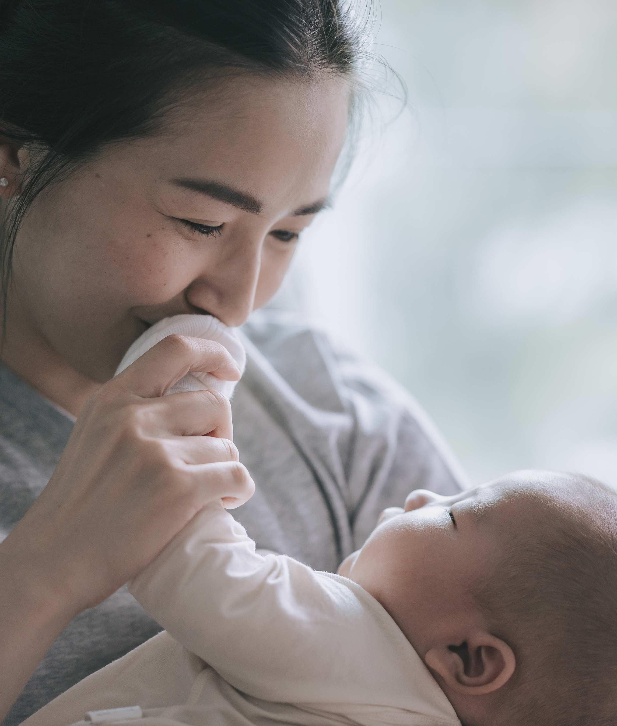
Olympic Connect: How does it work?
Meet “Ashley”, 25 years old, and “Annabelle”, 4 months old, living in Forks, WA.
Ashley and Annabelle come to First Step Family Support Center for diapers and share the following needs:
Newly single parent with limited social support
Currently unemployed and no high school diploma or GED
Currently living with friends and unsure how long this will last
No primary care for self or baby

Slide 21
Olympic Connect: How does it work?
First Step and Ashley complete online intake form together and begin to identify Ashley’s needs and goals.
Ashley’s case is formally assigned to First Step Family Support Center. There is no delay in Ashley getting started.
Ashley and her helper navigate available resources and services based on her prioritized goals (diapers, food bank, WIC, TANF, housing resource center, primary care, GED course).
First Step tracks Ashley’s outcomes and ensures she doesn’t fall through the cracks.
Ashley’s goals are achieved, and she is discharged.

Slide 22
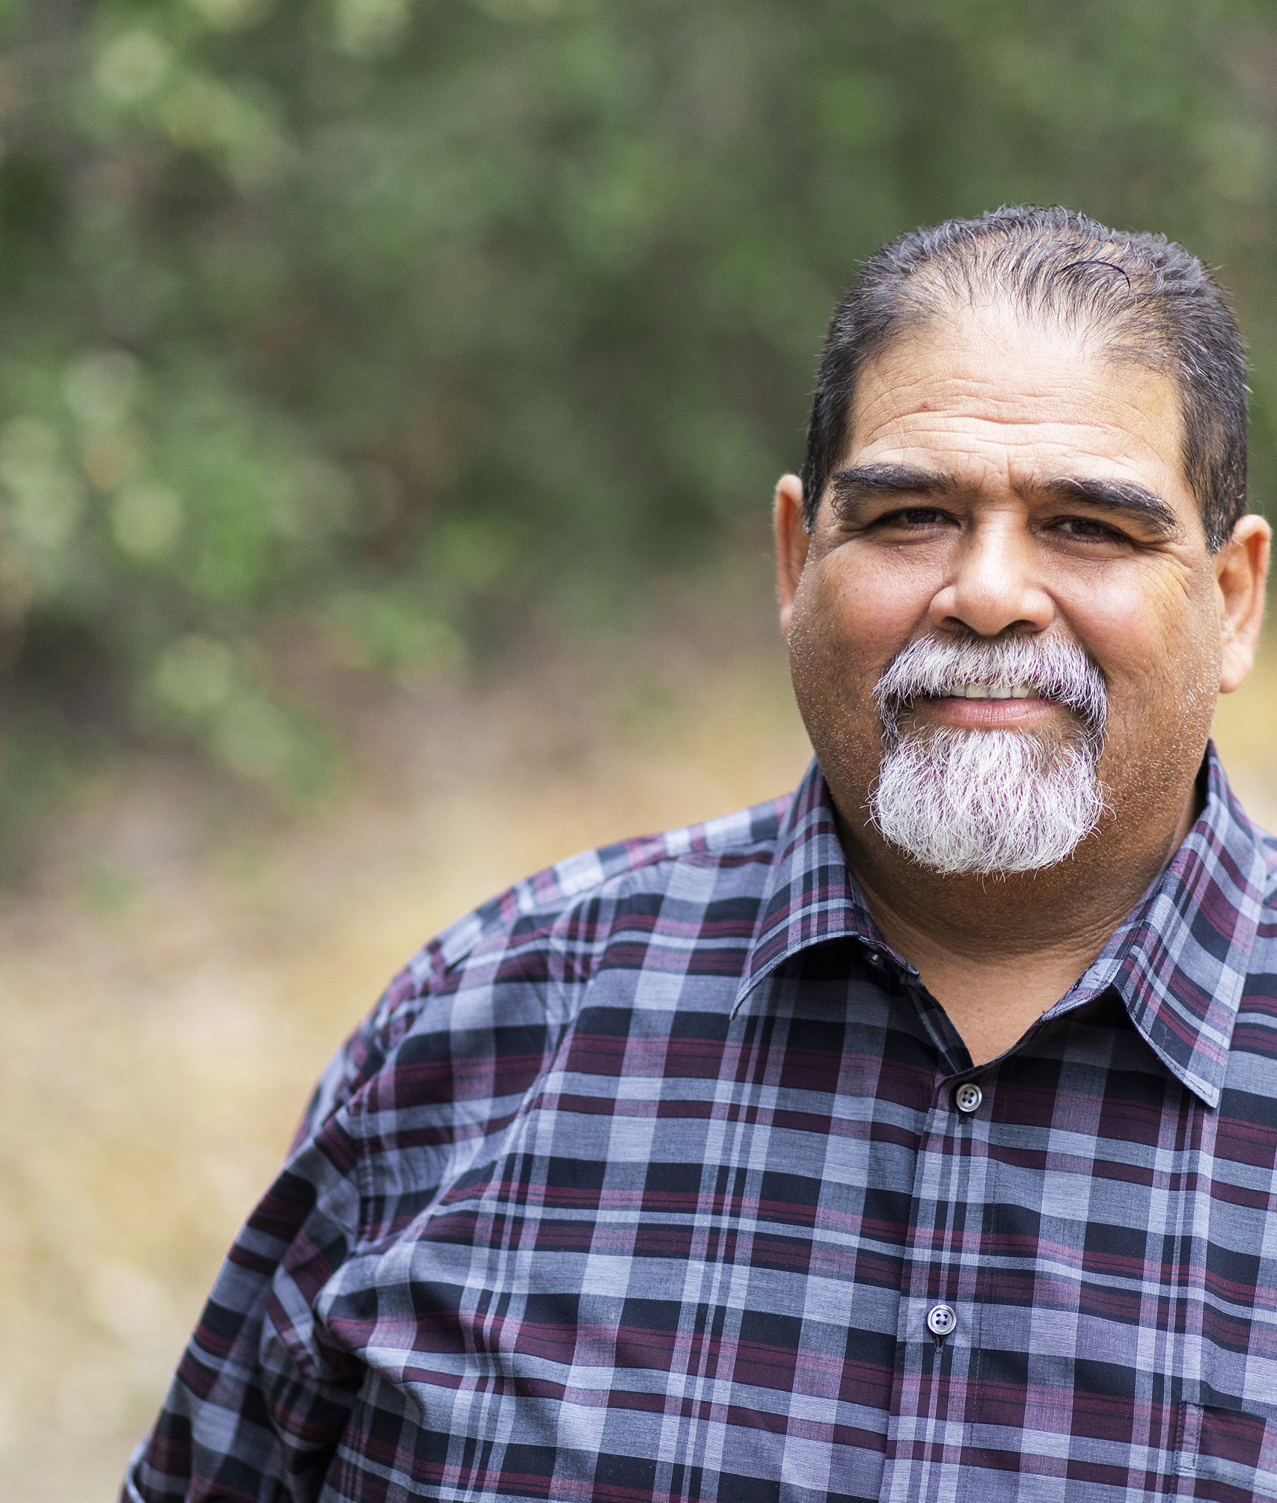
Olympic Connect: How does it work?
Meet “Bob”, 50 years old, living in Port Orchard, WA.
Bob is screened for social needs at a primary care doctor visit. On his screening he identifies:
Healthy diet and lifestyle
Food insecurity
Difficulty paying for utilities
Social isolation

Slide 23
Olympic Connect: How does it work?
Primary Care provider refers Bob to Olympic Connect.
Bob’s case is assigned to the YMCA of Pierce & Kitsap Counties who has expertise in social isolation, food needs, and utility programs in South Kitsap.
Bob and his trusted helper identify and prioritize his needs. They navigate local resources services (food bank, utility assistance programs, YMCA membership for social connections and healthy lifestyle, Diabetes Prevention Program).
Bob’s helper tracks his outcomes and ensures he doesn’t fall through the cracks.
Bob’s goals are achieved, and he is discharged.

Slide 24

Olympic Connect: How does it work?
Meet “Charlie”, 14 years old, living in Port Townsend, WA.
Charlie has recently been skipping classes and is generally disengaged at school. School based services connects with Charlie where he shares:
Family recently homeless and living out of car
Food insecurity
Feeling anxious and depressed

Slide 25
Olympic Connect: How does it work?
School based services build trust with Charlie and connect with family.
School and family call Olympic Connect together.
Family’s case is assigned to Olympic Peninsula YMCA who has expertise working with families in East Jefferson.
Family and trusted helper identify and prioritize needs and navigate local resources (housing, food bank, financial assistance, behavioral health treatment, social connections)
Trusted helper tracks outcomes and ensures family doesn’t fall through the cracks. Family works towards self-advocacy and discharge.

Slide 26

Olympic Connect: How does it work?
Meet “Dana”, 32 years old, living in Quilcene, WA.
Dana learns about Olympic Connect from a friend. She calls the local phone number seeking help for:
Housing is unstable
History of substance use disorder and seeking support in her recovery
Feeling depressed
Currently unemployed. Needs childcare and transportation to effectively seek a job.

Slide 27
Olympic Connect: How does it work?
Olympic Connect shares how the process works with Dana and assigns her case to Quilcene Fire CARES who has expertise in South Jefferson.
Trusted helper and Dana identify and prioritize her goals. Together, they navigate local resources (transportation, childcare, employment assistance, recovery support, mental health treatment, housing resources).
Trusted helper tracks outcomes and ensures Dana doesn’t fall through the cracks.
Dana identifies her needs are met and she is discharged from the program.

Slide 28
How to partner
Everyone has an important role to play.
Notes:
We are stronger together and everyone has an important role to play as we work together to improve the systems of care in the Olympic region. ​

Slide 29





How to partner
LEARN
Sign up for OCH’s e-newsletter
Participate in an OCH convening, learning opportunity, or event
CONNECT
Identify, screen and connect community members to
Olympic Connect
PROVIDE
Contribute to a regional resource directory
Provide resources and services to community members
Expand & enhance access to
social care
COORDINATE
Provide care coordination services to address
social needs
Use a hope-centered approach to support community members to meet their goals
CHAMPION
Governance partner
Advisory group member
Olympic Connect Ambassador
Notes:
There are many ways to partner with Olympic Connect.
You can simply learn more by signing up for OCH’s e-newsletter or participate in an upcoming convening, training, or event. Most OCH events are free and open to anyone who lives, works, or plays in the Olympic region.
You can connect community members by identifying, screening, or connecting potential Olympic Connect clients. Olympic Connect is free and available to anyone who lives in the Olympic region.
You can provide resources and services to community members, actively work to expand and enhance access to social care, and/or contribute to and utilize a regional resource directory.
You can coordinate by providing care coordination for social needs, and use a hope-centered approach to support community members in meeting their goals. Later in 2025 there will be opportunities for more partners to tap into the Olympic Connect infrastructure to further care coordination efforts not funded by Olympic Connect.
You can champion by becoming a governance partner, advisory group member, or Olympic Connect ambassador to spread the word.

Slide 30
How to partner
Those partnering with Olympic Connect will have access to shared regional technology.
Resource directory that is locally stewarded.
Client management system for tracking client data and outcomes.
Referral and communication system to both make and close the loop on referrals.
Law enforcement & first responders
Hospitals
Elected officials
Physical health
Behavioral health
Community members
Local government
Schools & colleges
Tribes
Public
health
Health
plans
Community-based & social service organizations
Notes:
Those partnering with Olympic Connect will have access to shared regional technology which will include an updated and locally stewarded resource directory, a client management system for tracking client data and outcomes, and a referral & communication system to both make and close the loop on referrals. ​
Later in 2025 there will be opportunities for additional partners to access the shared regional technology.

Slide 31







Timeline
EARLY 2025
Launch Olympic Connect.
MID- 2026
Fully functioning, mature hub.
NOV-DEC 2024
Care coordination & Expand and Enhance resources partner contracting.
NOV-DEC 2024
Care Coordination Partner training.
MID-LATE 2025
Additional opportunities to partner.
2028
Social care network.
Notes:
This work is a marathon, not a sprint. We’re intentionally taking time to listen, collaborate with local partners, and not get ahead of our funders. ​
We know you’re eager to learn more details and begin connecting community members. We’re eager to share those with you as they’re ready. ​
Olympic Connect will launch by early 2025.
We will intentionally start slow and small. Throughout 2025 we’ll be working on robust community outreach and engagement to spread the word.

Slide 32
Stay connected!
We look forward to partnering with YOU on our path forward.
Website - Coming December 2024
Email – Connect@OlympicCH.org
Phone: 360-301-8252
Notes:
There are many community care hubs models across the nation that have proven to be effective in improving health outcomes, reducing costs, and addressing equity in local communities. Washington State is a leader in this work as we’re set to be the first state in the nation with a statewide network of community care hubs, working in alignment across communities. ​
We’re all a part of building a new approach to this important work. ​
I believe that a better system to care for people with social needs is possible, and that together we’ll build a better future for our local communities. ​
OCH looks forward to working with YOU on our path forward.

